Slide 1
Jenkins

Slide 2

Objectives
In this chapter we will discuss:
What is Jenkins?
Jenkins Pipeline
Jenkins Agents

Slide 3
What is Jenkins?
Jenkins is an open-source automation server
Helps automate the parts of software development
building
testing
deploying
facilitating continuous integration and continuous delivery (CI/CD).
History:
Originally developed as the Hudson project in 2004
renamed to Jenkins in 2011.

Slide 4
Features of Jenkins
Extensible:
Large plugin ecosystem.
Distributed Builds:
Support for building across multiple platforms.
Easy Installation:
Simple setup process.
Each commit triggers a build
Extensive Community Support

Slide 5

Jenkins Nodes
Jenkins Slaves/Nodes offload the execution of tasks to distributed systems.
Benefits
Scalability by distributing the build
Parallel Execution of multiple jobs
Agents can be placed in different geographies
Isolation environment with different set up

Slide 6
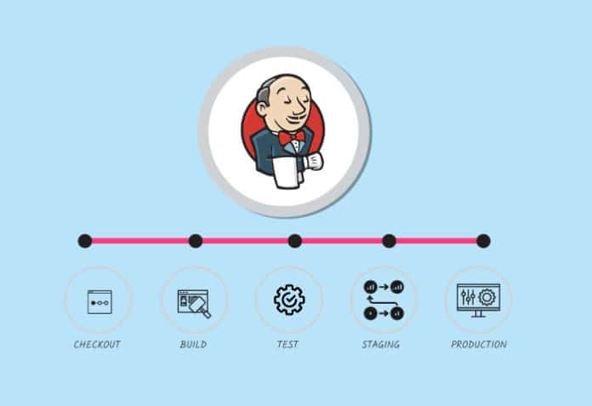
Jenkins Pipeline
Is a suite of plugins
Supports implementing and integrating CI/CD
Types of Pipelines:
Declarative Pipeline
Scripted Pipeline
Notes:
Picture from https://www.opensourceforu.com/2021/05/working-with-jenkins-pipelines/

Slide 7
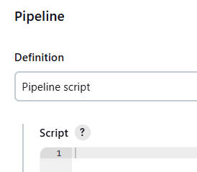
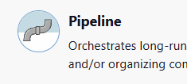

Benefits of Jenkins Pipeline
Version Control:
Pipeline as Code.
Complex Workflow Integration:
Supports complex build workflows.
Flexibility:
Easily integrates with other tools and technologies.
Durability:
Can survive Jenkins restarts and agent failures.

Slide 8
Basic Declarative Pipeline example
pipeline {
agent any
stages {
stage('Build') {
steps {
echo 'Building...'
}
}
stage('Test') {
steps {
echo 'Testing...'
}
}
stage('Deploy') {
steps {
echo 'Deploying...'
}
}
}
}
Build is a major phase
Steps are tasks within each stage
And so is Deploy

Slide 9
Another example
pipeline {
agent any
stages {
stage('Build') {
steps {
sh 'mvn clean package'
}
}
stage('Test') {
steps {
sh 'mvn test'
junit '**/target/surefire-reports/*.xml'
}
}
}
}

Slide 10
Summary:
Jenkins is a powerful tool for CI/CD.
Jenkins Pipelines enable automation of complex workflows.
Jenkins Agents allow for scalable and flexible build environments

Slide 11
THANK YOU
Hope you enjoyed this learning journey.

